Slide 1

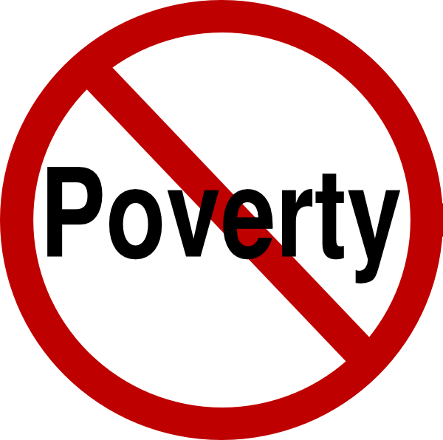
No Poverty

Slide 2
Introduction to poverty
Poverty is a state or condition in which one lacks the financial resources and essentials for a certain standard of living. Poverty can have diverse social, economic, and political causes and effects.
Preset Condition Of India ;
According to the recently released NITI Aayog report on the Multidimensional Poverty Index 2023, around 135 million Indians (One-tenth of the population) managed to escape poverty between 2016 and 2021, with significant progress observed in ‘standard of living’ indicators contributing to this positive change.
Notably, Bihar and Uttar Pradesh (UP) together accounted for a substantial portion of this progress, with 56.8 million individuals from these two states successfully moving out of multidimensional poverty. The report also indicates that the number of Indian states with less than 10% multidimensional poverty has doubled in a span of 5 years.

Slide 3
According to our opinion ;
As we know that, poverty in India , Is mainly due to the lack of Job & to have a job we require a certain qualifications ,Skills And many more.. Like certifications etc.
To search for a Job certain efforts are required . As a Part for Example ; Let an Engineer want an job on the basis of Campus Placement, He/She must require certain criteria to fulfil for the job. But He/She is not meeting that criteria. So, He/She goes for other off Campus Placements.
Its just a example for a engineer , but we are having many fields in any stream such as medical, agriculture, nursing, accounting .
So the idea we are having is not only for the employed person but will also help for the normal person.(shown on next slide)

Slide 4
Our Aim
1.We know that , we have apps in which we have to build our own profiles and then have to apply for a job with a resume and certifications.
2.But this will only help for a person have certain qualifications , but what about a guywho has not yet completed his professional course or not studied because of some reason.
3.The software that we are going to create will help every person who need any type of job (part time/full time) on the basis of their need .
4.The person who need a job will be able to choose job on the basis of their qualification or without qualification .
5.Recruiter and applicant will have to hire and choose job , according to them .
6.The main aim of this software/app is that “ it will help all the people who are employed or un employed or didn’t have pursued higher studies.

Slide 5

Presented By ; 1st Year students (CSE- AI)
Ashrita Singh
Ayushri Dhunde
Shivam Shahu
Piyush Kawale

